Slide 1
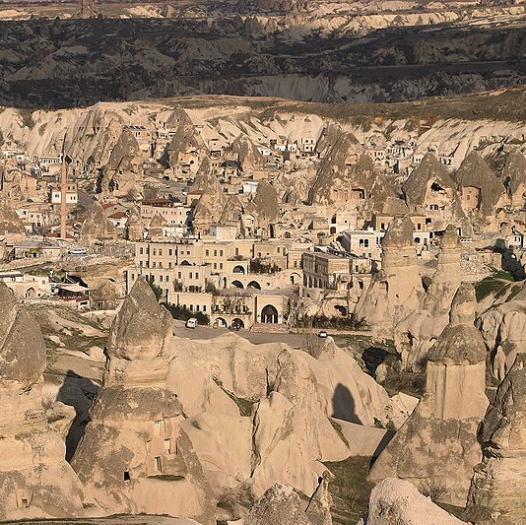
Environmental Performance of Tourism Accommodations in Protected Areas and Tourism Ecolabels in Turkey
Nazmiye Erdoğan
Başkent University
Turkey

Slide 2


Aims of the Research
To explore the nature of environmental performance of tourism accommodations in
Göreme Historical National park
To explicate the status of tourism ecolabels in Turkey
Notes:
2

Slide 3
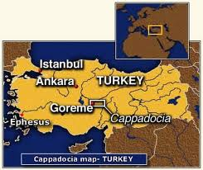
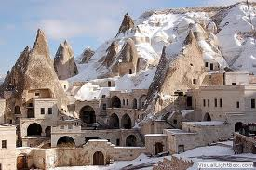
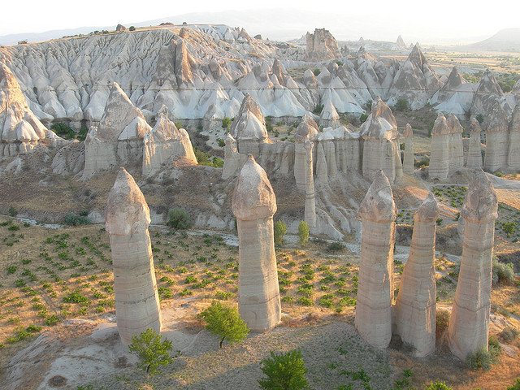
Göreme Historical National park
Park is located at Cappadocia region in Central Anatolia
UNESCO
World Heritage List
in 1985

Slide 4
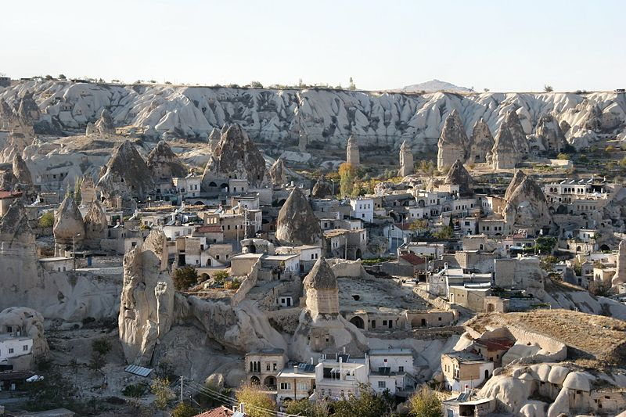
Cappadocia is known for its pinnacles of eroded volcanic ash, hundreds of churches and underground cities carved in the soft rock

Slide 5
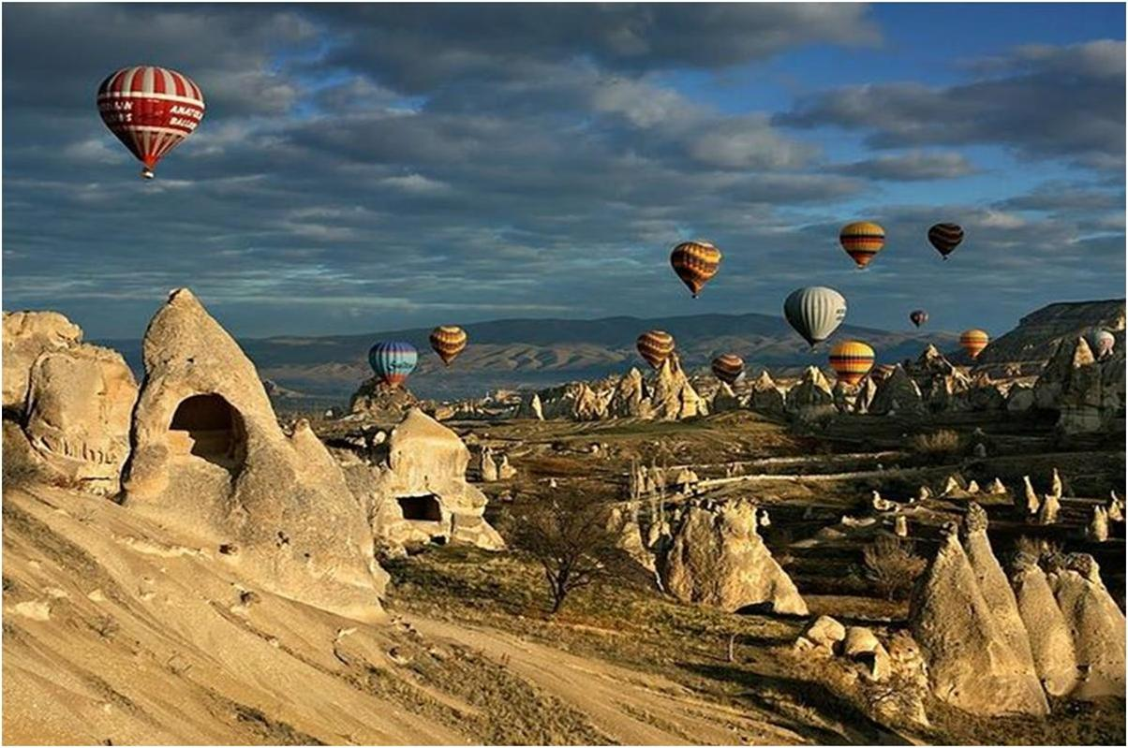
The area is a popular tourist destination

Slide 6
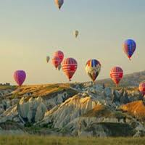
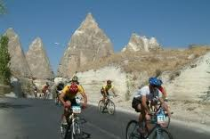
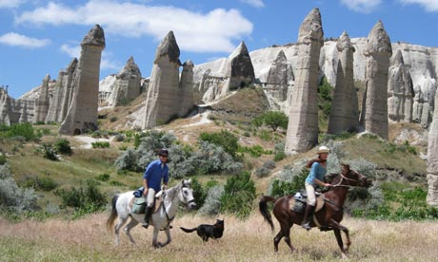
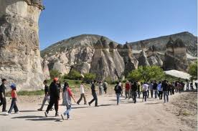
Hot air balloon trekking cycling
horse-riding

Slide 7
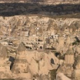
Theoretical Framework of the Study
This study builds upon the theoretical framework that the environmental performance is closely related with the environmental impacts of the prevailing policy and management activities of the tourism establishments.

Slide 8
Preferred Environmental Performance means:
The minimization of the negative effects on the natural environment that stem from the character of daily production activities and relations in the tourism industries

Slide 9
Accommodation sector in Turkey
Is only recently being investigated from the environmental perspective and not much work has been published in this area

Slide 10
Awards and ecolabel accreditation
Self-regulatory mechanisms for improving the industry's environmental performance
Many of the standards focus on accommodation, and in particular on hotels, but there are also very specific standards covering beaches, marinas, travel agency, tour operators, tour guides, protected areas

Slide 11
Ecolabel Schemes in Turkey
Turkey will continue to implement projects to preserve the environment and its cultural identity.
To evaluate the effects of tourism on environment
Relevant campaigns started in 1992

Slide 12
Ecolabel Schemes for Tourism Accommodation
in Turkey
Ecolabel/ award | Pine Award (National) | Green Star (National) | White Star (National) | Greening Hotels | Green Globe 21 | Green Key
Status | Voluntary | Vol. | Vol | Vol. | Vol. | Vol.
Focus Area | Accomod. | Accomod. | Accomod. | Accomod. | All | All
Initiation & Cessation Date | 1992 -2008 | 2009- | 2009- | 2009- | 1994 | 1994
Certified Member | Not used anymore | 22 hotels | 40 hotels | 43 hotels | 4 hotels | 4 hotels
Number of Criteria | - | 122 | 55 | 87 | - | 78
Certifying Authority | MCTR Public Authority | MCTR Public Authority | TUROFED NGO | TUROB NGO | WTTC | HORESTA NGO

Slide 13
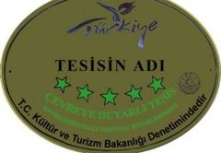

National ECOLABEL
Pine award
Green Star
White Star
Green Star
Pine award
White Star

Slide 14

Pine Award- Tourism Minister
Friend of the Environment
Harmony of the facility with nature,
Energy and water conservation, wastewater treatment and reuse
Environmental education materials for visitors, and training of the staff
Not used anymore

Slide 15
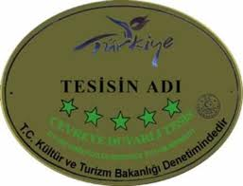

GREEN Star-Tourism Minister eco-friendly hotels
Environment policy, a private eco-manager, or be audited by a specialist firm
Water and energy usage, training employees to raise their environmental awareness
They should use local products in their menu at least twice a day
22 hotels

Slide 16

White Star-TUROFED
Livable Environment Project
Environmental Education
Environmental management system
Landscape design
Ecological architecture
Energy, Water, Wastewater managament
40 hotels

Slide 17




International ECOLABEL
Blue Flag
Greenings Hotels
Green Key
Green Globe 21

Slide 18
Blue Flag
Foundation for Environmental Education
IN TURKEY
Blue Flag beaches 324
Blue Flag marinas 17

Slide 19
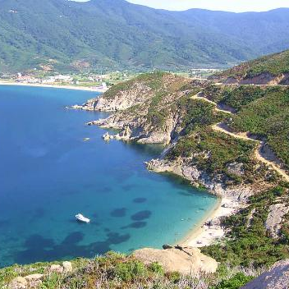
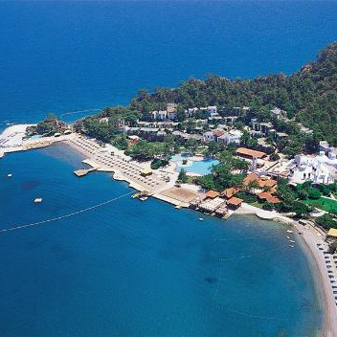
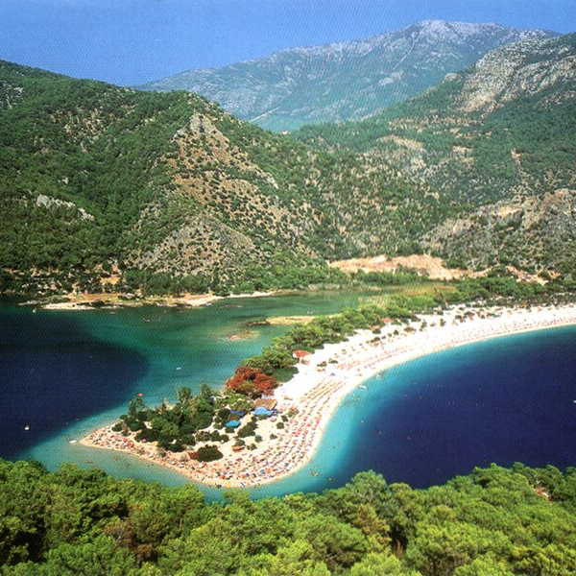
324
Blue flag beaches

Slide 20
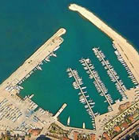
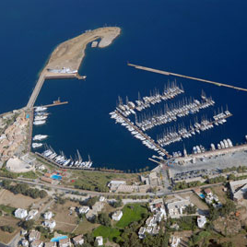
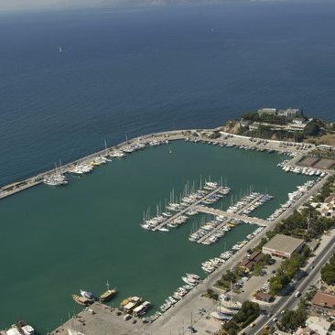
17
Blue Flag Marinas

Slide 21


Greening Hotels TUROB
Touristic Hotels & Investors Associations leads to this idea via Greening Hotels Project
Audits are made objectively by one of the world’s biggest accreditation firms
43 HOTELS

Slide 22


Green Globe 21 - WTTC
As a follow-up to the Earth Summit, in 1994 World Tourism and Travel Council set up GG21
GG21 provides guidance material and a certification process linked to both ISO standards and Agenda 21 principles
4 HOTELS

Slide 23


The Green Key HORESTA
Hotel, Restaurant and Leisure Industry Association
Applies 78 criteria to be met by properties seeking certification
Foundation for Environmental Education
4 HOTELS

Slide 24
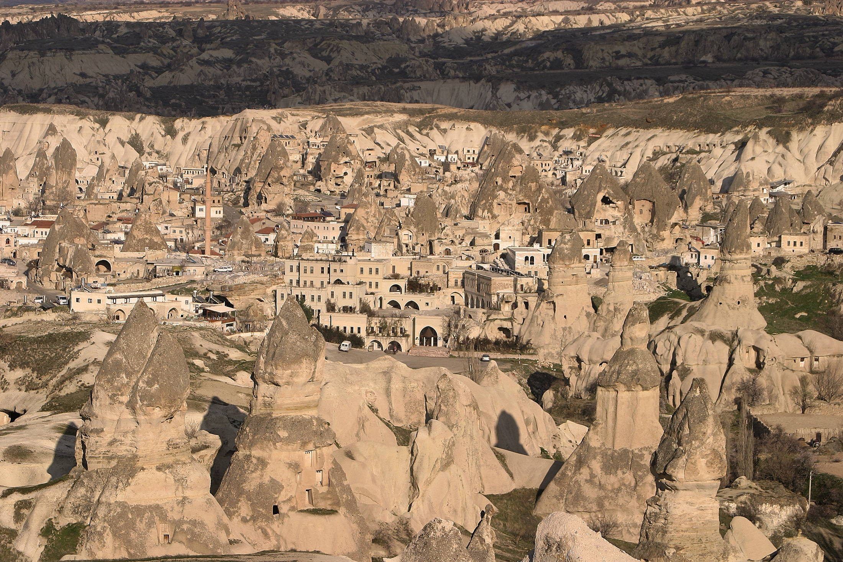
Method

Slide 25
Study population
104 Accommodation in the study area.
78 Managers completed the survey
73 Valid questionnaires

Slide 26
Distribution of the accomodations
Accommodation groups | Accommodation status | Total in the region | Total in the study
GROUP A | Five-star | 3 | 3
 | Four-star | 18 | 17
 | Three-star | 10 | 9
GROUP B | Special-licenced | 30 | 22
 | Apart hotel | 2 | 1
GROUP C | Two-star | 13 | 4
 | One-star | 3 | 3
 | Boarding house | 25 | 14
TOTAL |  | 104 | 73
0 = no performance 4= the highest performance

Slide 27
Environmental performance
categories and distribution of the indicators
Cat No. | Performance Categories | Number of indicators
1 | Architecture and landscape design | 4
2 | Energy efficiency/resource conservation | 7
3 | Waste reduction | 5
4 | Water efficiency/conservation | 4
5 | Education and training for environmental awareness | 4
6 | Communication for environmental awareness | 5
7 | Managerial knowledge on environmental protection | 3
8 | Others | 7

Slide 28
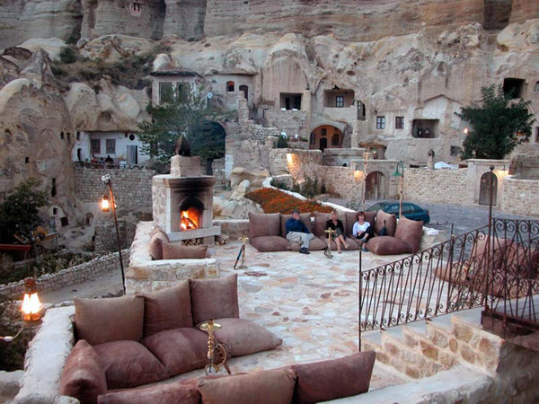
Findings
Notes:
28

Slide 29

Low environmental performance
    Energy efficiency
    Water conservation
    Waste management
    Environmental training
    Environmental awareness
    Environmental policy

Slide 30
1. Architecture and landscape design
Groups and Performance Indicators | Group A mean | Group B mean | Group C mean | Total mean
Using local material in construction | 2.35 | 3.17 | 2.71 | 2.73
Hotel architecture in harmony with environment | 2.81 | 3.57 | 2.71 | 3.03
Garden planning suitable with environment | 2.92 | 3.39 | 2.82 | 3.06
Plan that does not spoil natural and historical environment | 2.74 | 3.74 | 2.86 | 3.10
Group mean | 2.71 | 3.47 | 2.78 | 2.98
0 = no performance 4= the highest performance
Notes:
30

Slide 31
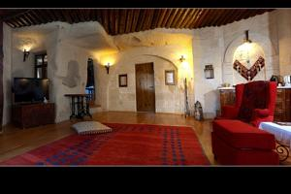
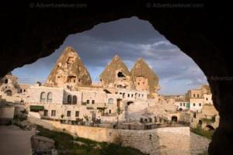
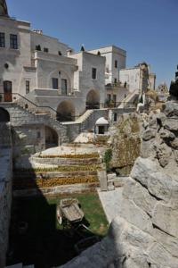
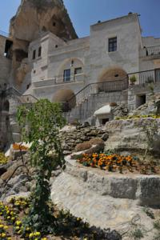
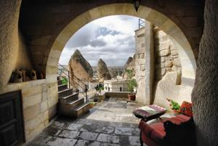
Using natural material in construction Special-licenced hotels

Slide 32

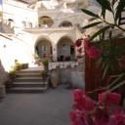


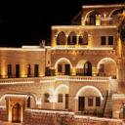
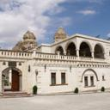
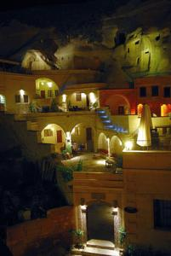
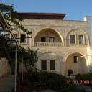
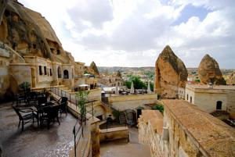
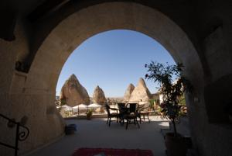
Hotel architecture in harmony with environment

Slide 33
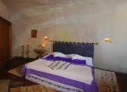
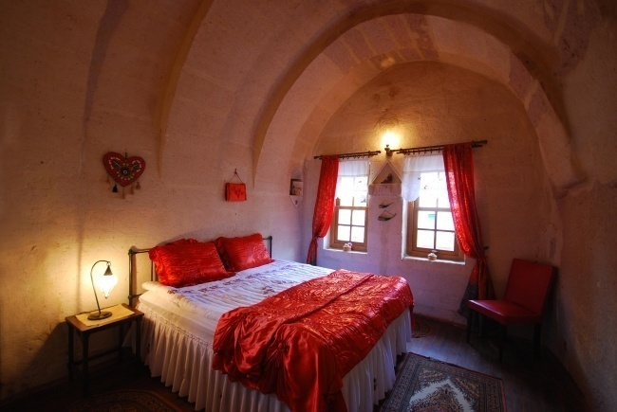
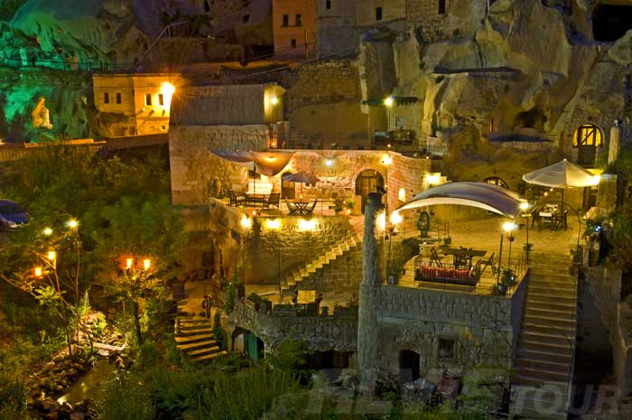
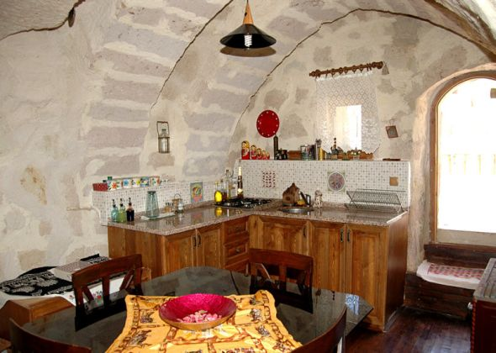
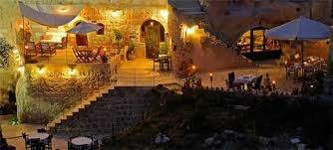
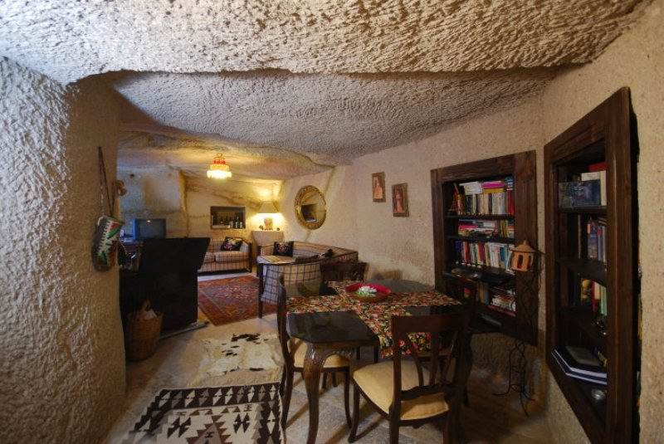
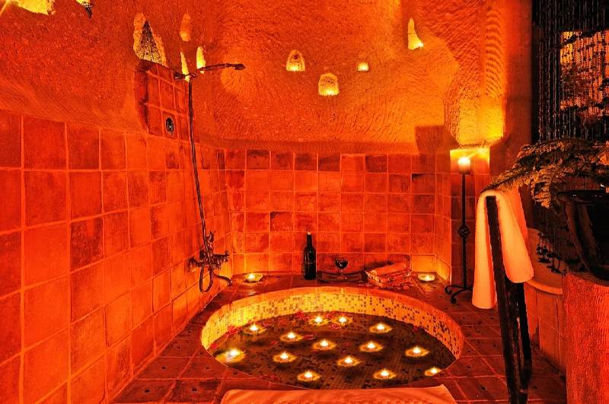
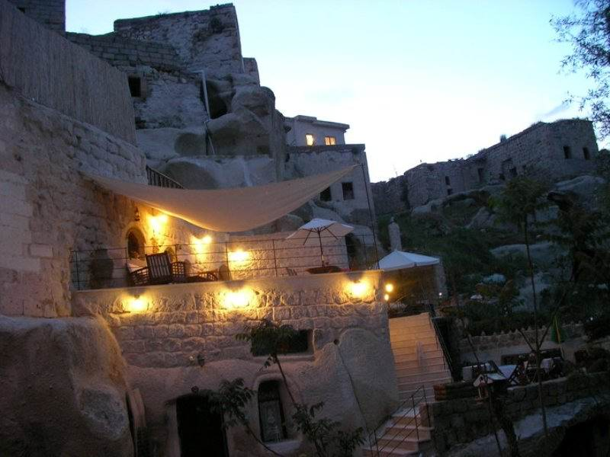
ÖYKÜ HOUSE

Slide 34
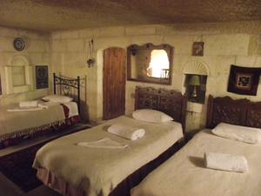
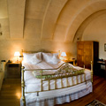
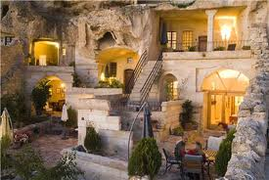
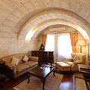
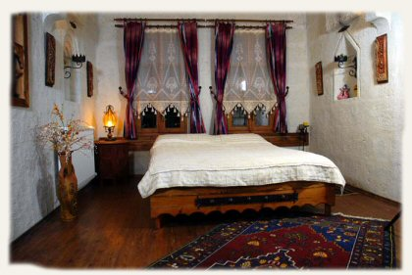

Slide 35
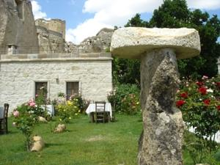
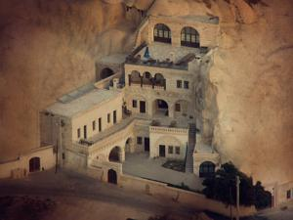
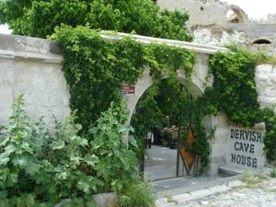
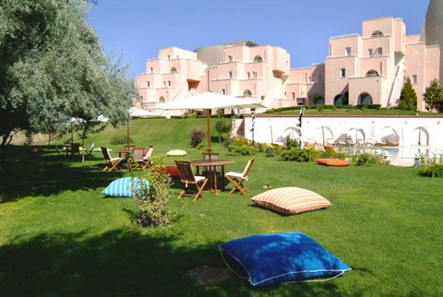
Garden planning suitable with environment

Slide 36




Slide 37
2. Energy efficiency
Groups and Performance Indicators | Group A Mean | Group B Mean | Group C Mean | Total Mean
Using key-card control system in guest rooms | 1.50 | .65 | .19 | .85
Energy-saver control system in guest rooms | .67 | .36 | .00 | .38
Using solar energy | 1.50 | 1.36 | 1.10 | 1.34
Using photocell lighting in washrooms | 2.21 | 1.24 | .95 | 1.55
Using phosporate cat-eye in lighting outside | 0.69 | 0.62 | 0.18 | .51
Purchasing low energy consuming materials | 2.44 | 2.05 | 2.30 | 2.28
Using the energy saving light bulbs in rooms | 2.97 | 2.23 | 2.43 | 2.58
Group mean | 1.71 | 1.22 | 1.02 | 1.36
Notes:
37

Slide 38
3. Waste management and reduction
Groups and Performance Indicators | Group A Mean | Group B Mean | Group C Mean | Total Mean
Solid waste separation at source | 1.28 | 1.36 | 1.81 | 1.46
Using recycled paper in brochures | 1.07 | 0.78 | 0.90 | 0.93
Composting the organic and food waste | 0.41 | 0.19 | 0.43 | 0.35
Purchasing materials with recyclable feature | 1.59 | 1.61 | 1.67 | 1.62
Cooperation with recycling firms | 1.21 | 0.09 | 0.62 | 0.68
Group mean | 1.11 | 0.81 | 1.09 | 1.01
Notes:
38

Slide 39
4. Water efficiency and conservation
Groups and Performance Indicators | Group A Mean | Group B Mean | Group C Mean | Total Mean
Using treated water in garden irrigation | 0.32 | 0.14 | 0.10 | 0.20
Wastewater treatment | 0.59 | 0.35 | 0.24 | 0.41
Using photocell water armateurs | 0.93 | 0.27 | 0.43 | 0.58
Using water saving measures on linen change | 1.81 | 1.82 | 2.52 | 2.03
Group mean | 0.91 | 0.65 | 0.82 | 0.81
Notes:
39

Slide 40
5. Education and training for
environmental awareness
Groups and Performance Indicators | Group A Mean | Group B Mean | Group C Mean | Total Mean
Providing environmental education to personnel | 1.86 | 0.83 | 1.00 | 1.29
Providing environmental training to personnel | 1.10 | 0.57 | 0.81 | 0.85
Providing environmental education to guests | 1.32 | 0.52 | 0.81 | 0.92
Participating in environmental meetings | 2.18 | 1.17 | 1.20 | 1.58
Group mean | 1.62 | 0.77 | 0.96 | 1.16
Notes:
40

Slide 41
6. Communication for environmental awareness
Groups and Performance Indicators | Group A Mean | Group B Mean | Group C Mean | Total Mean
Brochures with information on environmental protection | 1.25 | 0.55 | 0.76 | 0.89
Getting guest opinions on environmental activities | 2.07 | 1.74 | 1.90 | 1.92
Reflecting guest opinions to hotel activities | 2.11 | 2.77 | 1.95 | 1.96
Encouraging guests to use mass transportation | 1.50 | 1.17 | 1.80 | 1.48
Posting educational posters for customers | 1.34 | 0.83 | 1.33 | 1.18
Group mean | 1.65 | 1.41 | 1.55 | 1.49
Notes:
41

Slide 42
7. Managerial knowledge
on the environmental protection
Groups and Performance Indicators | Group A Mean | Group B Mean | Group C Mean | Total Mean
Knowledge on the ISO 14001 | 1.27 | 0.59 | 0.95 | 0.96
Knowledge on the Pine Awards | 1.30 | 0.78 | 0.85 | 1.00
Knowledge on the Blue Flag | 1.52 | 1.43 | 1.71 | 1.55
Group mean | 1.36 | 0.93 | 1.17 | 1.17
Notes:
42

Slide 43

Recommendations

Slide 44
Recommendations
There is a need for environmentally sensitive practices.
Education and training courses should be developed and participation of accommodation personnel encouraged.
The environmental knowledge and sensitivity of managers should be enhanced.
They should participate in resource saving practices and make a commitment to institute a resource minimization policy, allocate staff and necessary funding for implementation, and establish an energy performance rating system and a periodic or continuous monitoring system to assess the nature and outcome of the daily practices.

Slide 45

A strong and co-operative partnership between
    Government departments
    National tourism authorities
    International and national tourism associations
    The travel and tourism private sector

Slide 46
There is a need for ecolabel schemes in tourism accommodations, especially in protected areas as an integrated part of the environmental performance
Environmental sensitivity
Social responsibility

Slide 47
Thank you for listening

